Slide 1
UF Policy RAG Chatbot: End-to-End Deep Dive
Rohan Bagulwar

Slide 2
CONTENT
01
RAG Foundation
02
Core GenAI Components
03
Data Ingestion & Indexing
04
Retrieval & Generation Services
05
Deployment & Architecture
06
Evaluation & Benchmarking

Slide 3
01
RAG Foundation

Slide 4

UF Policy RAG Chatbot: NLP & Vector Search
01
Project Overview
This project implements a Retrieval-Augmented Generation (RAG) system to bridge the domain knowledge gap for public LLMs by grounding answers in UF policy documents. The goal is to ensure factual accuracy and relevance in responses.
02
Core Technologies
The architecture leverages Python 3.10, utilizing a microservices pattern wrapped in a FastAPI REST API layer. This setup ensures high performance and scalability, making it suitable for real-time applications.
03
Closed-Book Operation
RAG operates in a closed-book mode, meaning it can only generate answers based on the retrieved policy chunks. This prevents the model from hallucinating information not grounded in the provided data.
汇报人：xxx 汇报时间：x年x月x日

Slide 5
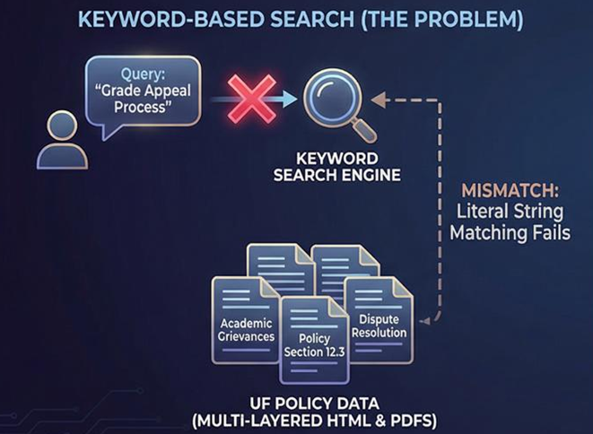
Data Challenge & Need for Semantic Search
Complex Data Structure
UF policies are scattered across multi-layered HTML and PDF documents, making it challenging to extract relevant information using traditional keyword-based search methods. The data is initially compiled into a structured JSON file.
Semantic Search Requirement
To address the semantic gap, the system employs semantic similarity search. For example, querying 'grade appeal process' should retrieve content discussing 'academic grievances,' which requires understanding the underlying meaning rather than exact keyword matches.

Slide 6
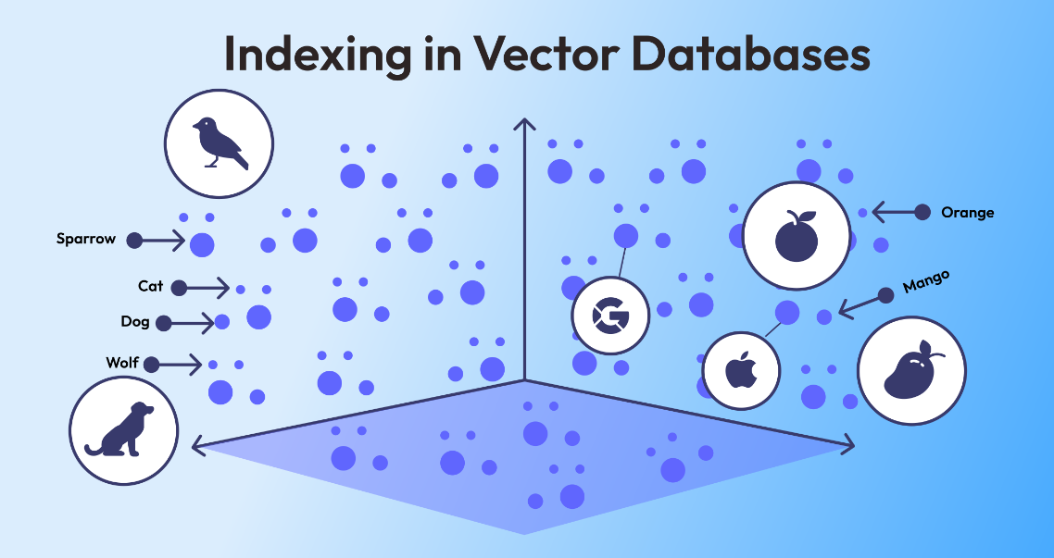



Closed-Domain RAG Workflow
1
Text Extraction & Chunking
2
Creating Embeddings
Raw documents (e.g., UF Policies) are scraped, cleaned, and split into smaller, manageable chunks (e.g., 1000 characters) using a Text Splitter.
Each text chunk is converted into a numerical vector (embedding) using an Embedding Model (e.g., BGE). Similar text will have vectors close together in space.
3
Vector Database Storage
4
Semantic Matching
These embeddings and their corresponding text chunks are stored in a specialized Vector Database (e.g., ChromaDB) for efficient similarity search.
The User Question is converted to a vector. The database searches for the closest matching policy vectors using Cosine Similarity, retrieving the most relevant chunks (Top-K).
5
Answer Generation
The retrieved chunks are injected into the Large Language Model's (LLM) prompt as context. The LLM (e.g., GPT-OSS) generates a factual answer only using that provided context, preventing hallucination.

Slide 7
02
Core GenAI Components

Slide 8
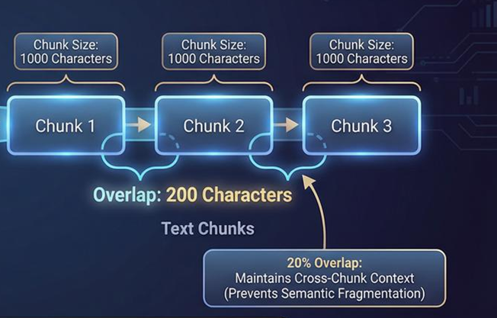
LangChain Recursive Text Splitting
Text Chunking
LangChain's RecursiveCharacterTextSplitter is used to split policy text into manageable chunks. The configuration includes a chunk size of 1000 characters and an overlap of 200 characters to ensure context preservation.

Slide 9
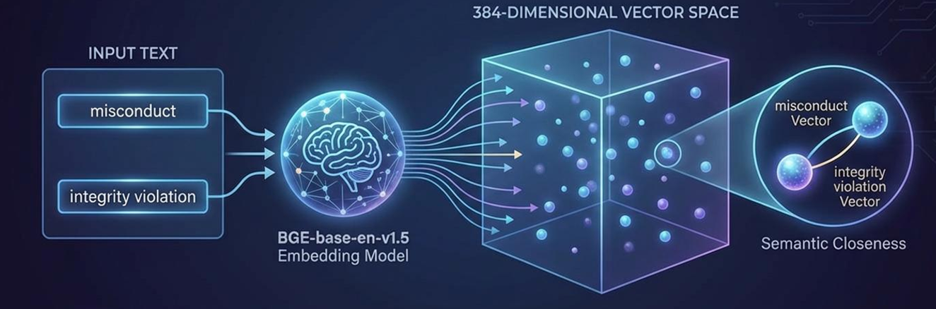
BGE Embeddings: Semantic Vectorization
Embedding Model
The BGE Embedding Model (BAAI/bge-base-en-v1.5) is used to convert text into high-dimensional vectors. The 384D variant is chosen for its balance between performance and retrieval quality.
Semantic Similarity: Text fragments with similar meanings are mapped to vectors that are numerically close in the 384-dimensional space. This enables the system to understand and retrieve relevant information based on semantic intent.

Slide 10
ChromaDB Vector Store Architecture
Vector Storage
Search Mechanism
Metadata Storage
ChromaDB serves as the open-source vector store, handling the persistent storage of embeddings and policy text.
The database uses Cosine Similarity to measure the angular distance between the user's query vector and the policy vectors in the policies collection, enabling efficient retrieval of relevant chunks.
Each chunk's metadata, including its original URL and title, is stored alongside its vector. This metadata is crucial for providing accurate citations in the final response.

Slide 11
03
Data Ingestion & Indexing

Slide 12
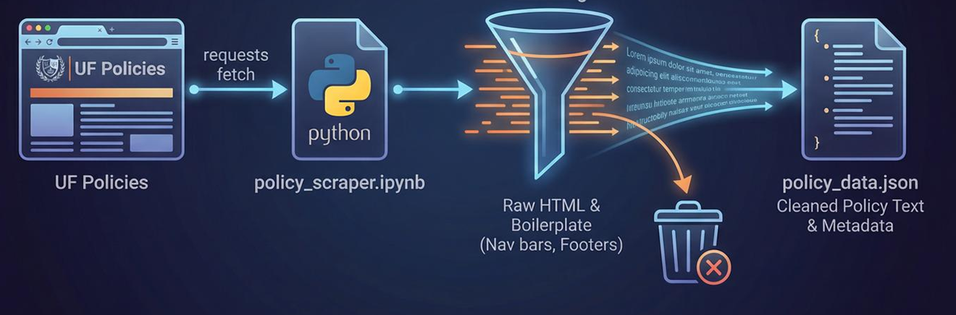
Policy Scraping & Cleaning Pipeline
01
Data Acquisition
Data is scraped from UF policy websites. HTML pages are fetched, and BeautifulSoup is used to strip non-content elements, isolating the policy text.
02
Output Format
The cleaned policy text is compiled into a structured JSON file, which serves as the input for the indexing process. This step ensures high-quality embeddings.
汇报人：xxx 汇报时间：x年x月x日

Slide 13
Hierarchical Chunking Strategy
Part
Part
Part
One
Two
Three
Chunking Configuration
Recursive Splitting
Overlap Strategy
The chunking strategy prioritizes separators to respect document hierarchy: paragraph breaks, line breaks, sentence ends, and word spaces. This ensures semantic coherence in each chunk.
The RecursiveCharacterTextSplitter recursively splits the text, ensuring that chunks are as semantically coherent as possible before resorting to arbitrary cuts.
A 20% overlap (200 characters) is used to prevent semantic fragmentation. This ensures that context from the previous chunk is present at the beginning of the next chunk.
01
02
03

Slide 14
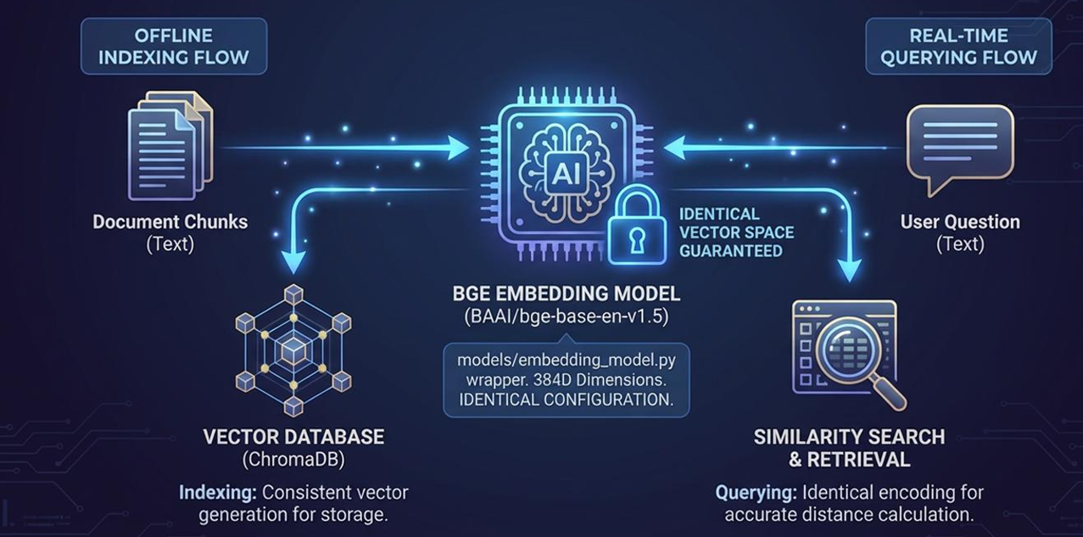
Embedding Model Initialization
The BGE model is loaded via hugging face. The same model and parameters used for indexing are employed for query embedding during retrieval, ensuring accurate similarity calculations.
Model Consistency

Slide 15
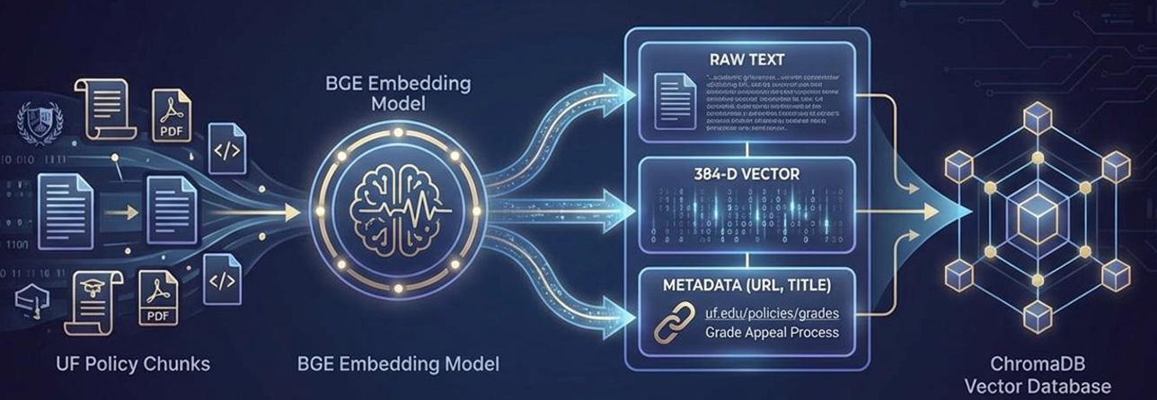
Vectors in chroma db
Vector Generation
Metadata Importance
Storing metadata alongside vectors is crucial for providing accurate citations in the final response. It ensures that users
can verify the source of the information.
Each text chunk is passed through the BGE model to generate its vector representation. The chunk text, its vector, and metadata (URL, title) are stored in the ChromaDB policies collection.

Slide 16
04
Retrieval & Generation Services

Slide 17
FastAPI REST Layer Design
01
FastAPI Overview
FastAPI serves as the high-performance REST layer, providing auto-generated documentation (Swagger UI) and supporting efficient API interactions.
02
Main Orchestrator
The main orchestrator pulls configurations from config.py and manages service dependency injection. This structure supports a clear separation of microservices.
03
Scalability
The architecture is designed to support independent scaling of retrieval and generation services, enabling efficient deployment in various environments.

Slide 18
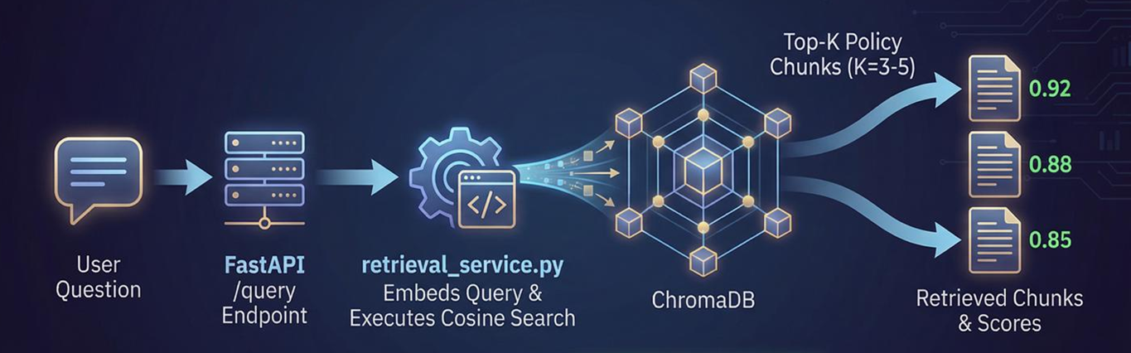
Real-Time Query Processing
Query Endpoint
Top-K Retrieval
User queries are processed via the FastAPI /query endpoint. The retrieval service embeds the query using the BGE model and performs a similarity search in ChromaDB.
The system retrieves the top-k (3-5) most relevant policy chunks based on cosine similarity. This ensures that the LLM receives the most pertinent context for generating an accurate response.

Slide 19
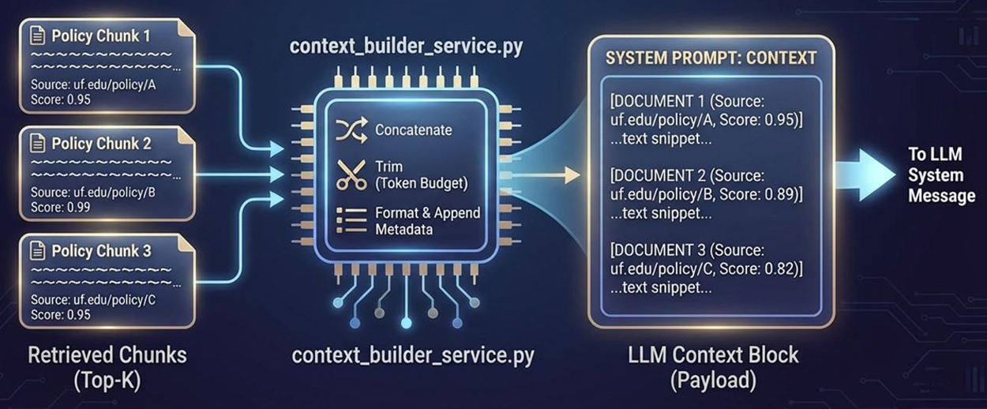
Context Building Service
01
02
03
Context Preparation
Metadata Integration
Prompt Structuring
The context building service concatenates the retrieved policy chunks and manages token limits to ensure the LLM receives a clean and relevant input payload.
The service formats the context with metadata and relevance scores, providing a comprehensive input for the LLM. This step ensures that the response includes accurate citations.
The final input payload is structured to include the user's question, retrieved context, and metadata, ensuring the LLM can generate a well-informed response.

Slide 20
Prompt Engineering Against Hallucination
Prompt Instructions
The prompt engineering service injects strict instructions into the system prompt, instructing the LLM to answer only from the provided context and to admit uncertainty if the answer is not found.

Slide 21
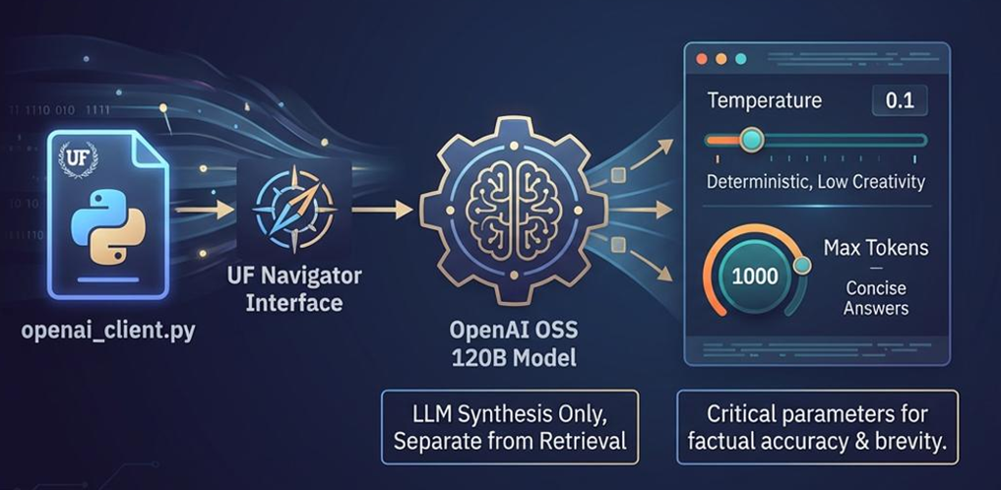

LLM Client Configuration
LLM Initialization
Parameter Settings
The LLM is initialized using the OpenAI OSS 120B Model accessed through the UF Navigator toolkit. This setup ensures high-quality responses.
Key parameters are set for deterministic output: Temperature is set to 0.1 for low creativity, and Max tokens is set to 1000. These settings ensure concise and factual responses.
汇报人：xxx 汇报时间：x年x月x日

Slide 22
05
Deployment & Architecture

Slide 23
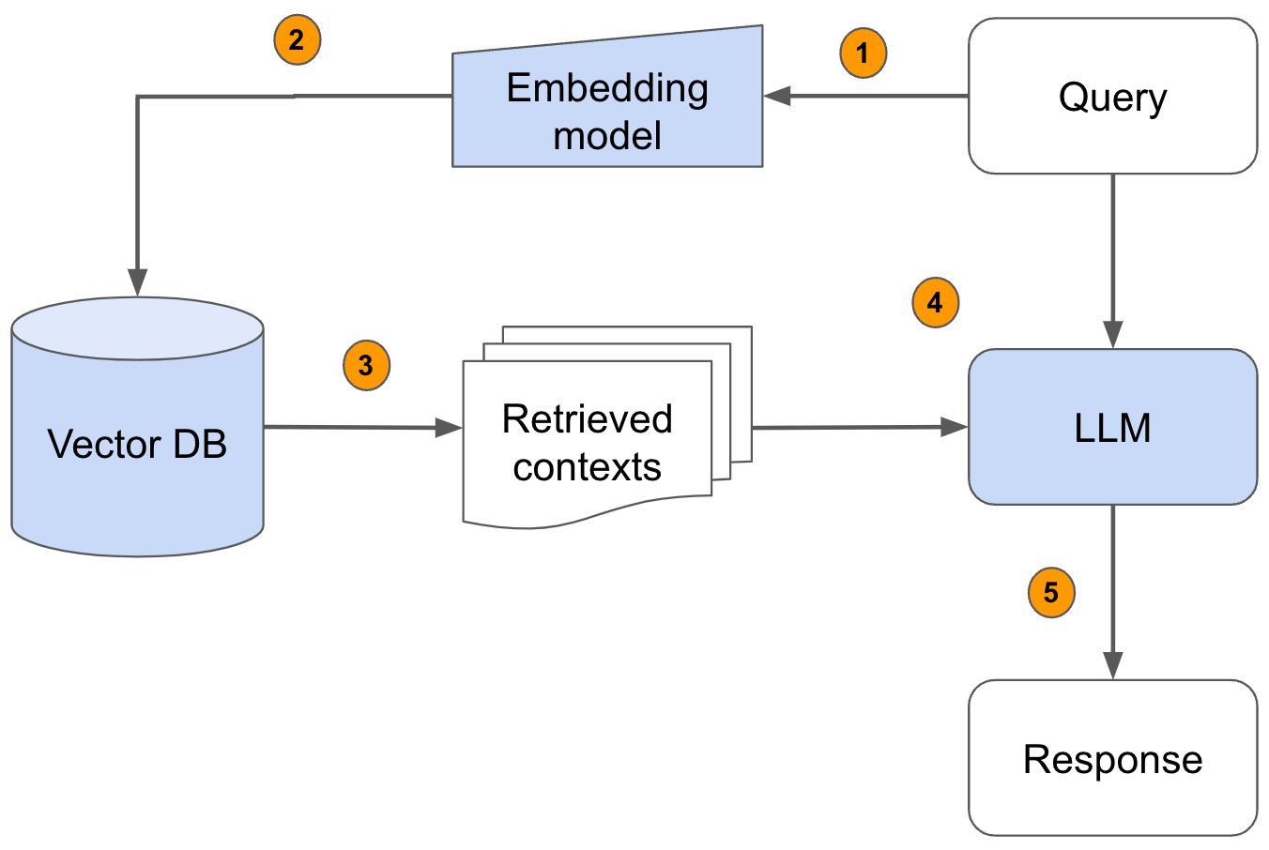
Architecture

Slide 24
06
Evaluation & Benchmarking

Slide 25
Evaluation Metrics: BLEU, ROUGE, METEOR
BLEU Metric
ROUGE Metric
METEOR Metric
BLEU measures precision based on exact n-gram matches against human-written references. A high score indicates a literal match, which is not always desirable for paraphrasing tasks.
ROUGE, specifically ROUGE-L, measures recall based on the Longest Common Subsequence (LCS). It focuses on the core facts and overall gist of the response, providing a more holistic evaluation.
METEOR incorporates synonym matching and stemming, offering a more nuanced evaluation that better correlates with human judgment. It balances precision and recall for a comprehensive assessment.

Slide 26
Ground-Truth Creation Methodology
Benchmarking Process
Benchmarking is conducted in the The first step involves manually generating a test set of questions and corresponding human ground truth answers from the UF policy website.
Gold Standard
The human ground truth answers serve as the gold standard for metric comparison, ensuring that the evaluation reflects factual accuracy and relevance.

Slide 27
LLM Comparison: GPT-OSS, Llama, Gemma
Model Selection
Context Consistency
Performance Metrics
Three LLMs available on the UF Navigator toolkit are tested: GPT-OSS 120B, Llama, and Google Gemma. This comparison isolates the generative performance of each model.
All models receive the same context retrieved by the pipeline, ensuring that the evaluation focuses solely on the LLM's ability to synthesize and generate accurate responses.
The models are evaluated using BLEU, ROUGE, and METEOR metrics to quantify paraphrase quality and factual accuracy, providing a comprehensive comparison.

Slide 28
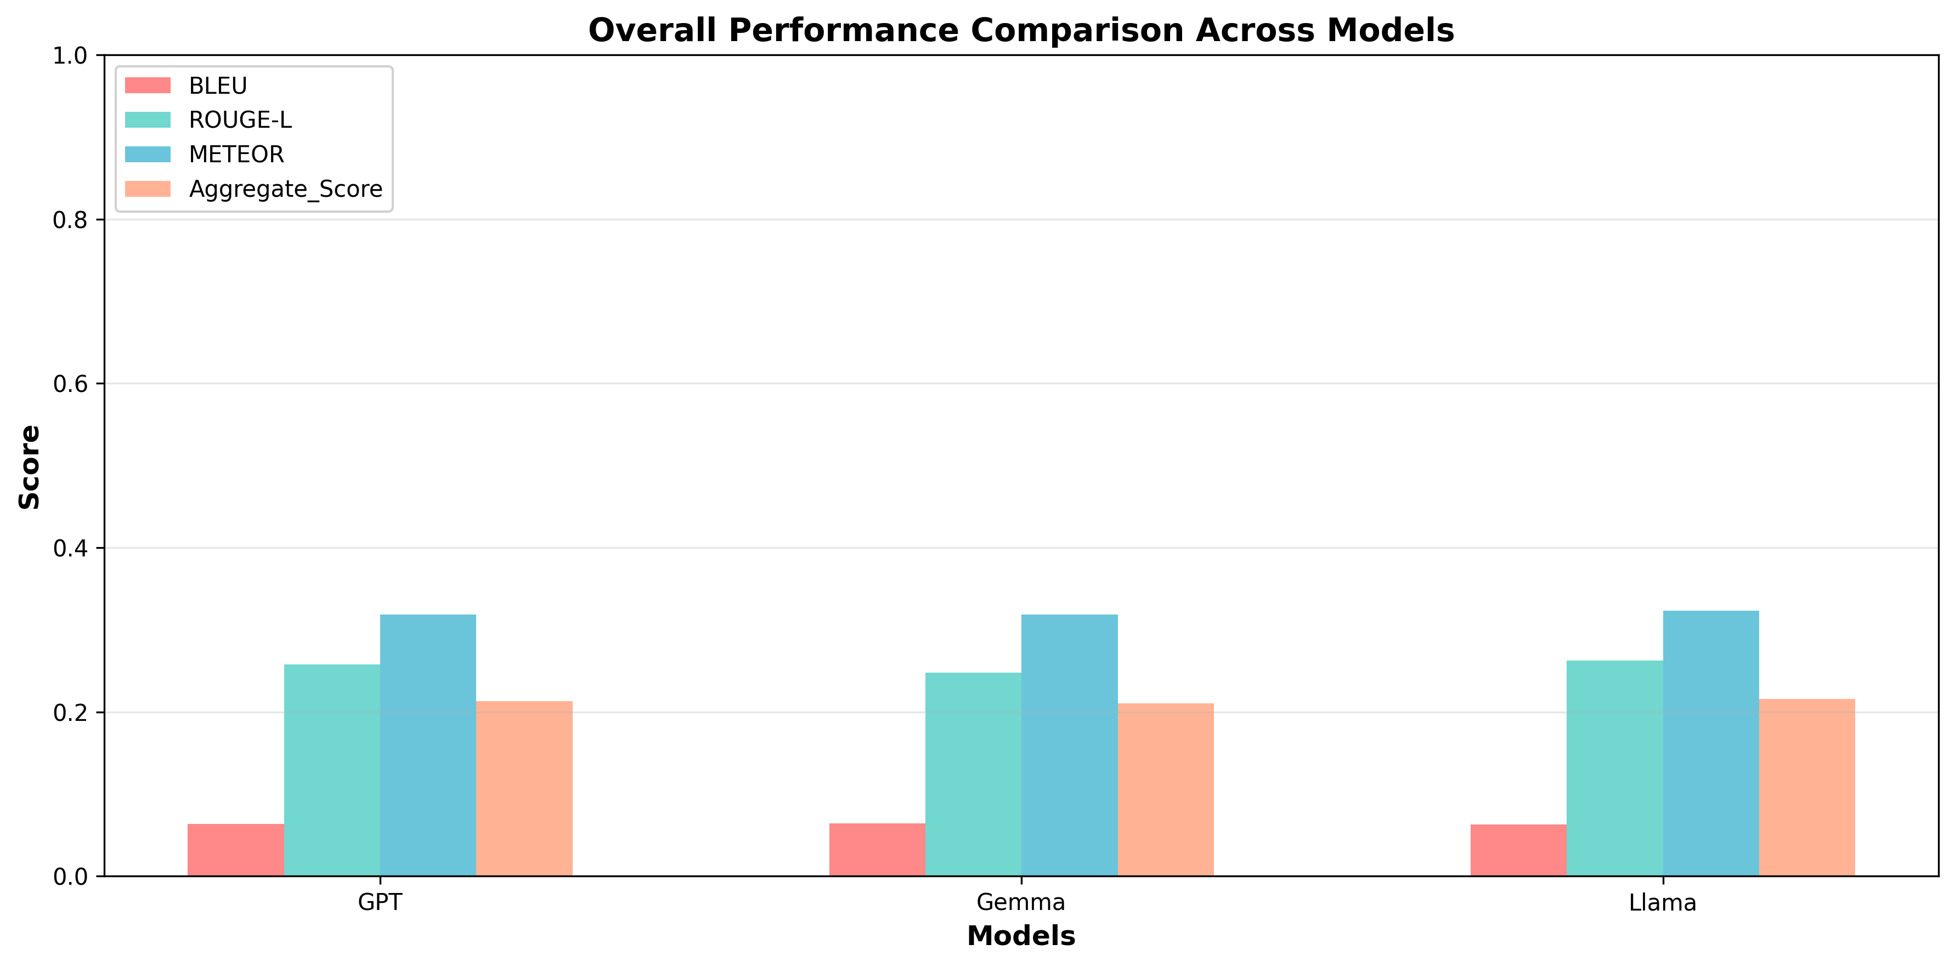
Aggregate Performance Overview
Performance Summary
All model shows smilar score, closely followed by GPT-OSS and Gemma. Low BLEU scores indicate effective paraphrasing rather than literal copying.

Slide 29
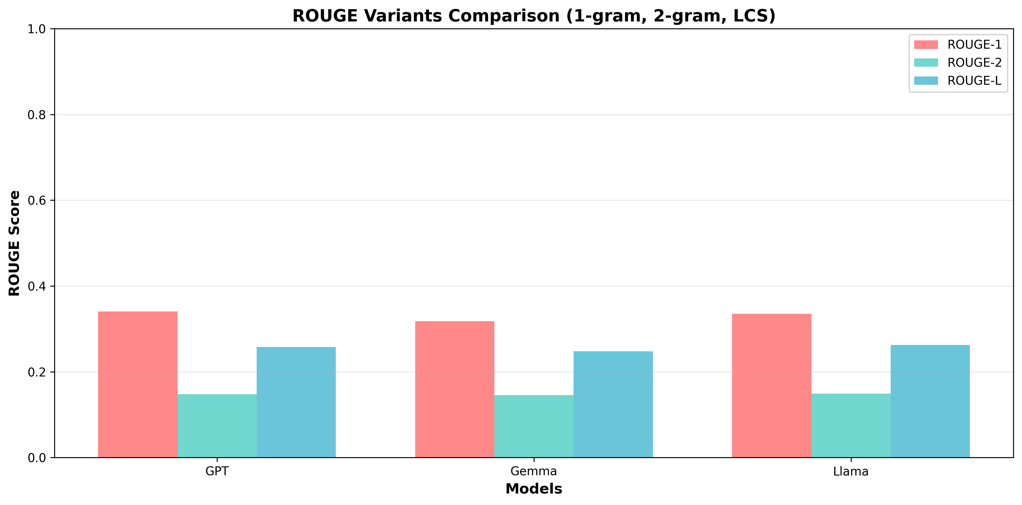
ROUGE Variant Gap Analysis
ROUGE Analysis
The large gap between ROUGE-1 and ROUGE-2 confirms that models generate unique phrasings and sentence structures, proving true synthesis rather than sequential word copying.
Synthesis Quality
The significant drop in ROUGE-2 scores indicates that models
effectively paraphrase content, ensuring that responses are
linguistically novel yet factually accurate.

Slide 30
THANK YOU

